Slide 1
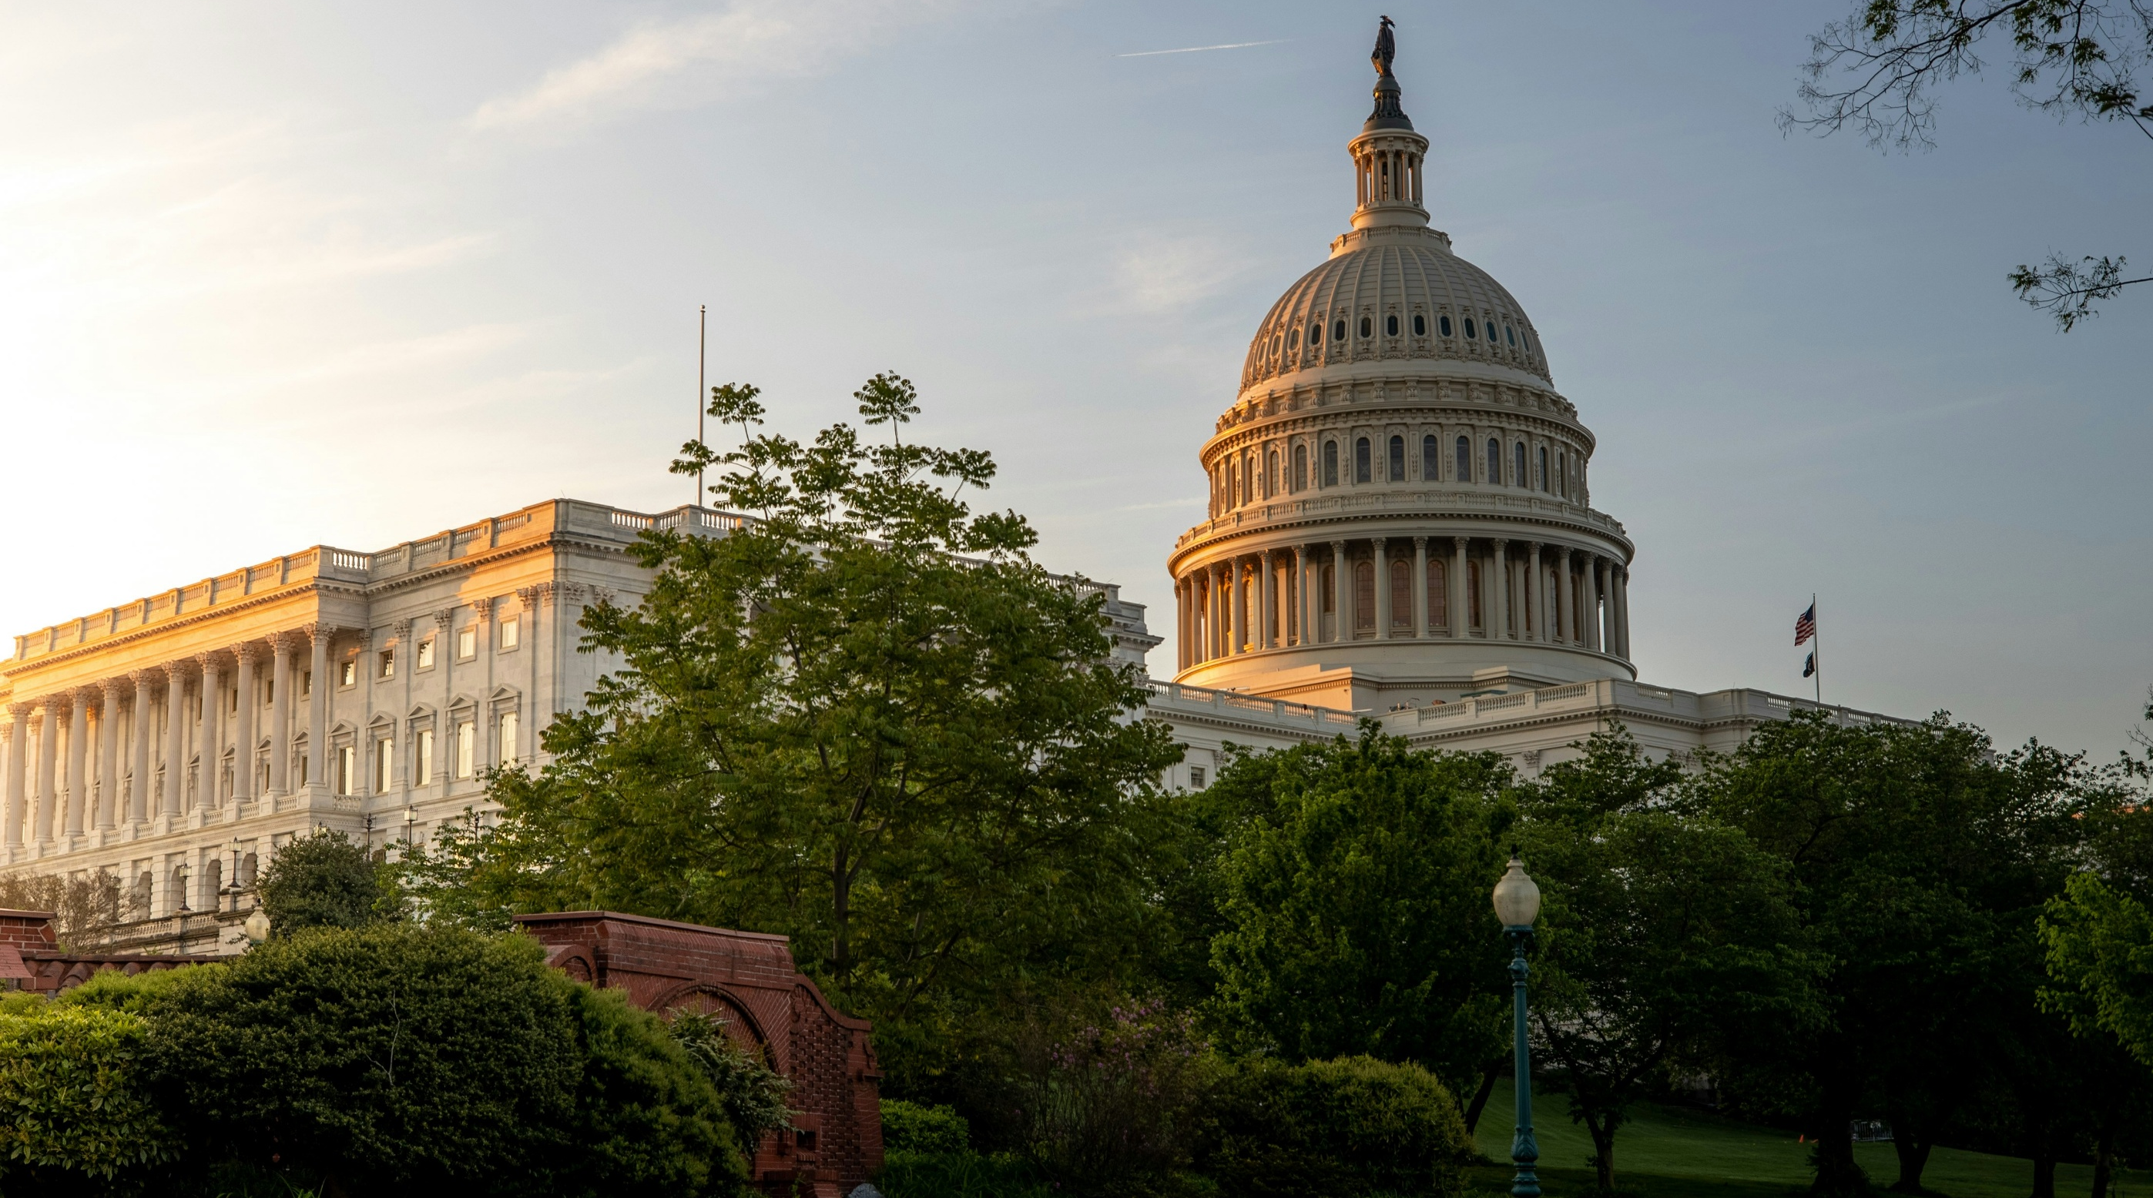

GOVERNMENT AFFAIRS
HOW-TO GUIDE

Slide 2
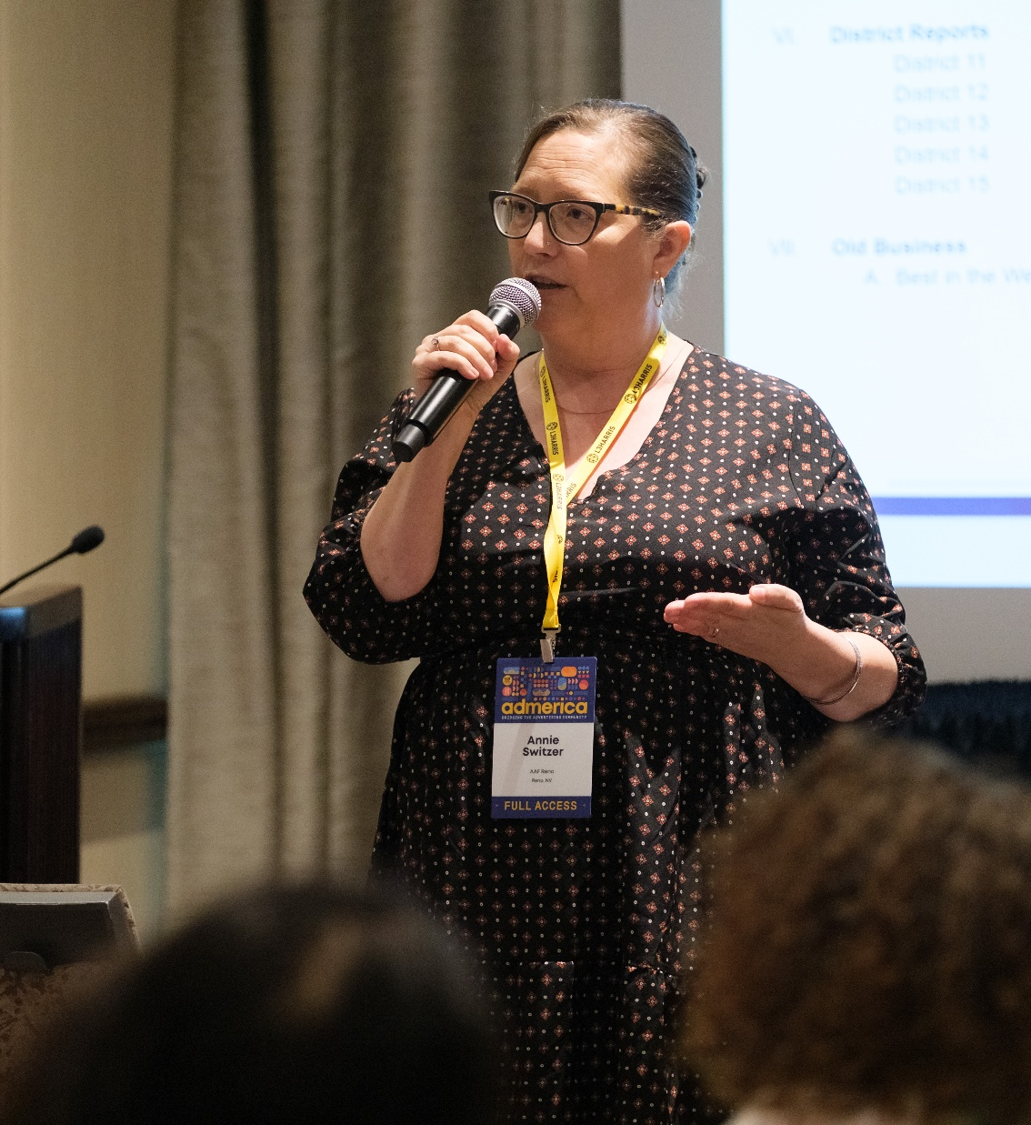
GOVERNMENT
AFFAIRS
Few aspects of local advertising chapter operations are as critical as government and legislative affairs. No other activity so directly affects how members conduct business – impacting compensation, content, and creative execution. Government Affairs is an important member benefit and can be highlighted in membership recruitment and retention efforts.
We know many members can be intimidated by interacting with elected officials and hesitate to engage in government relations. This manual aims to reduce any anxiety and demonstrate how chapters can effectively interact with lawmakers.

Slide 3

GOVERNMENT
AFFAIRS
As the unified voice of the advertising industry, the American Advertising Federation and our nationwide network of local chapters are best positioned to represent the advertising industry’s interests before legislators. AAF’s approach rests on two principles: lawmakers respond to constituents, and prevention is more effective than reaction.
Lawmakers listen the most to their constituents. For this reason, the local advertising industry, represented by local AAF chapters, must speak about issues affecting its work. Most often, the AAF goal is not to pass new laws but to prevent harmful ones – such as ad taxes, ad bans, or overly broad privacy protections. True success lies in preventing such proposals from being introduced. The best strategy is to educate lawmakers early about advertising’s economic and social value, making them less likely to support damaging legislation later.

Slide 4
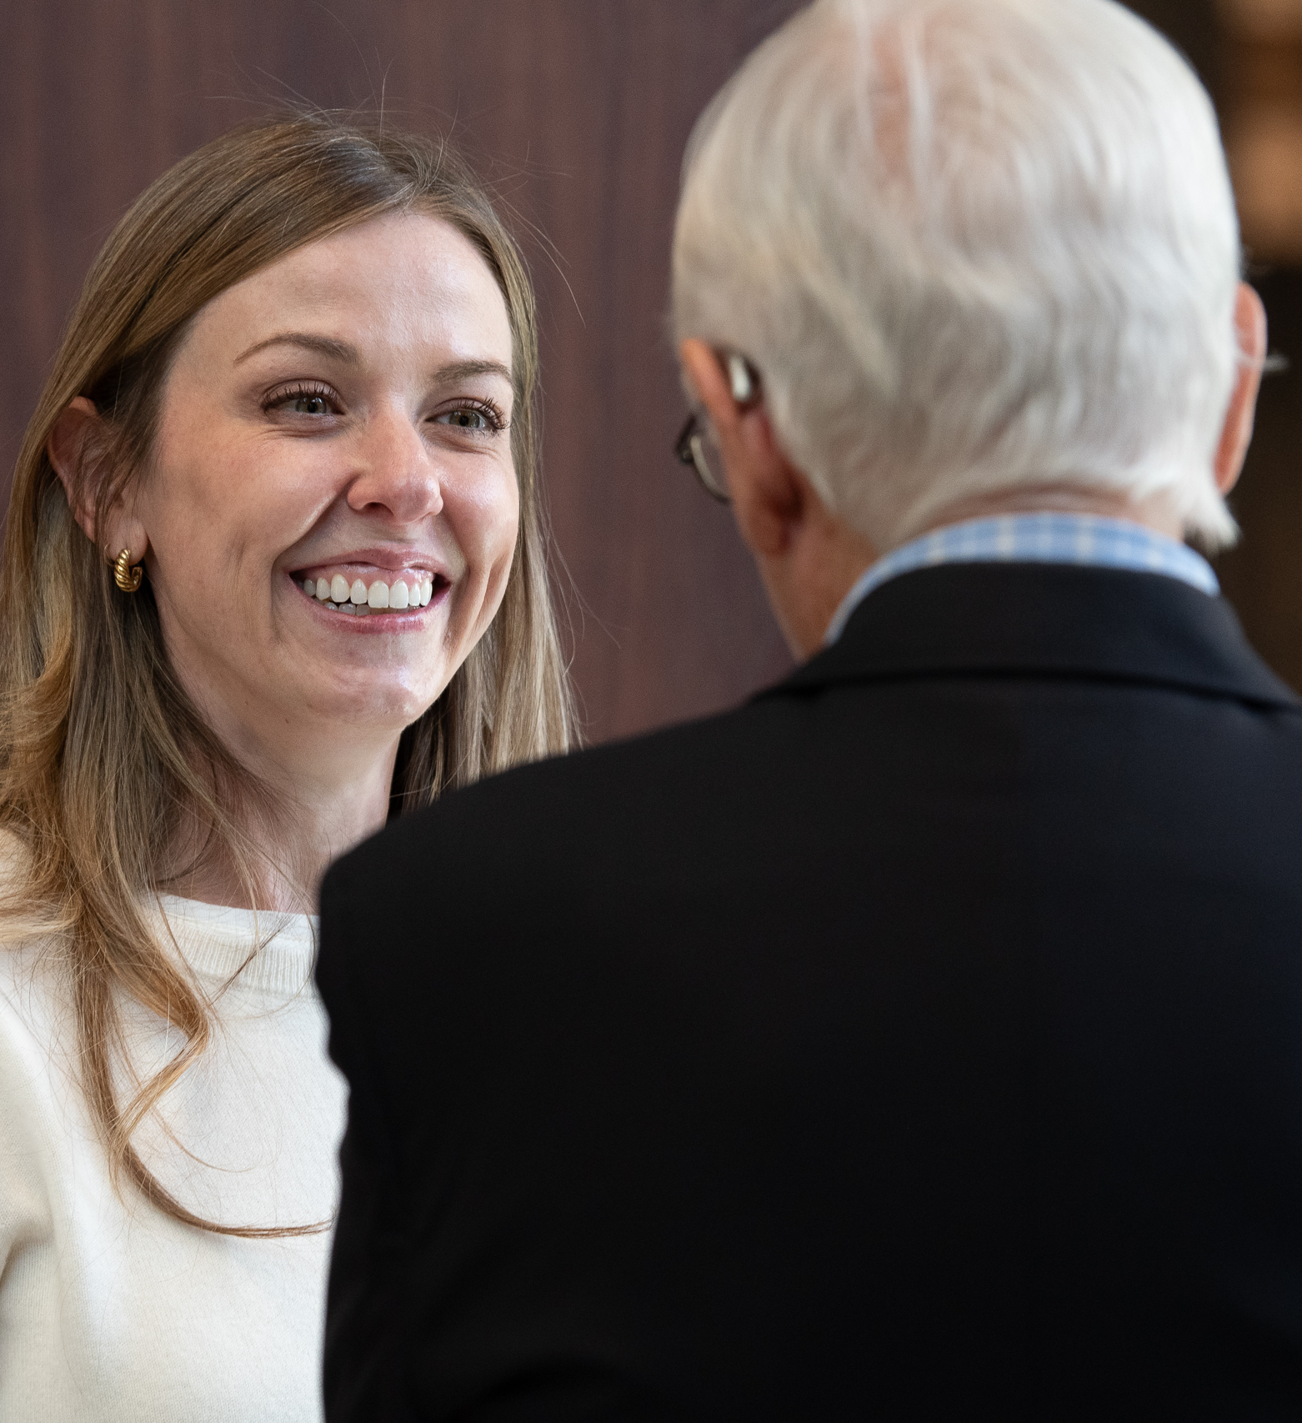
GOVERNMENT
AFFAIRS
Although specific legislative strategies vary, the AAF Government Affairs team stands ready to assist and work with local members when needed. Implementing these preventative steps will greatly reduce the likelihood of reactive lobbying campaigns.

Slide 5
APPOINTING A LEGISLATIVE CHAIR AND COMMITTEE

Slide 6
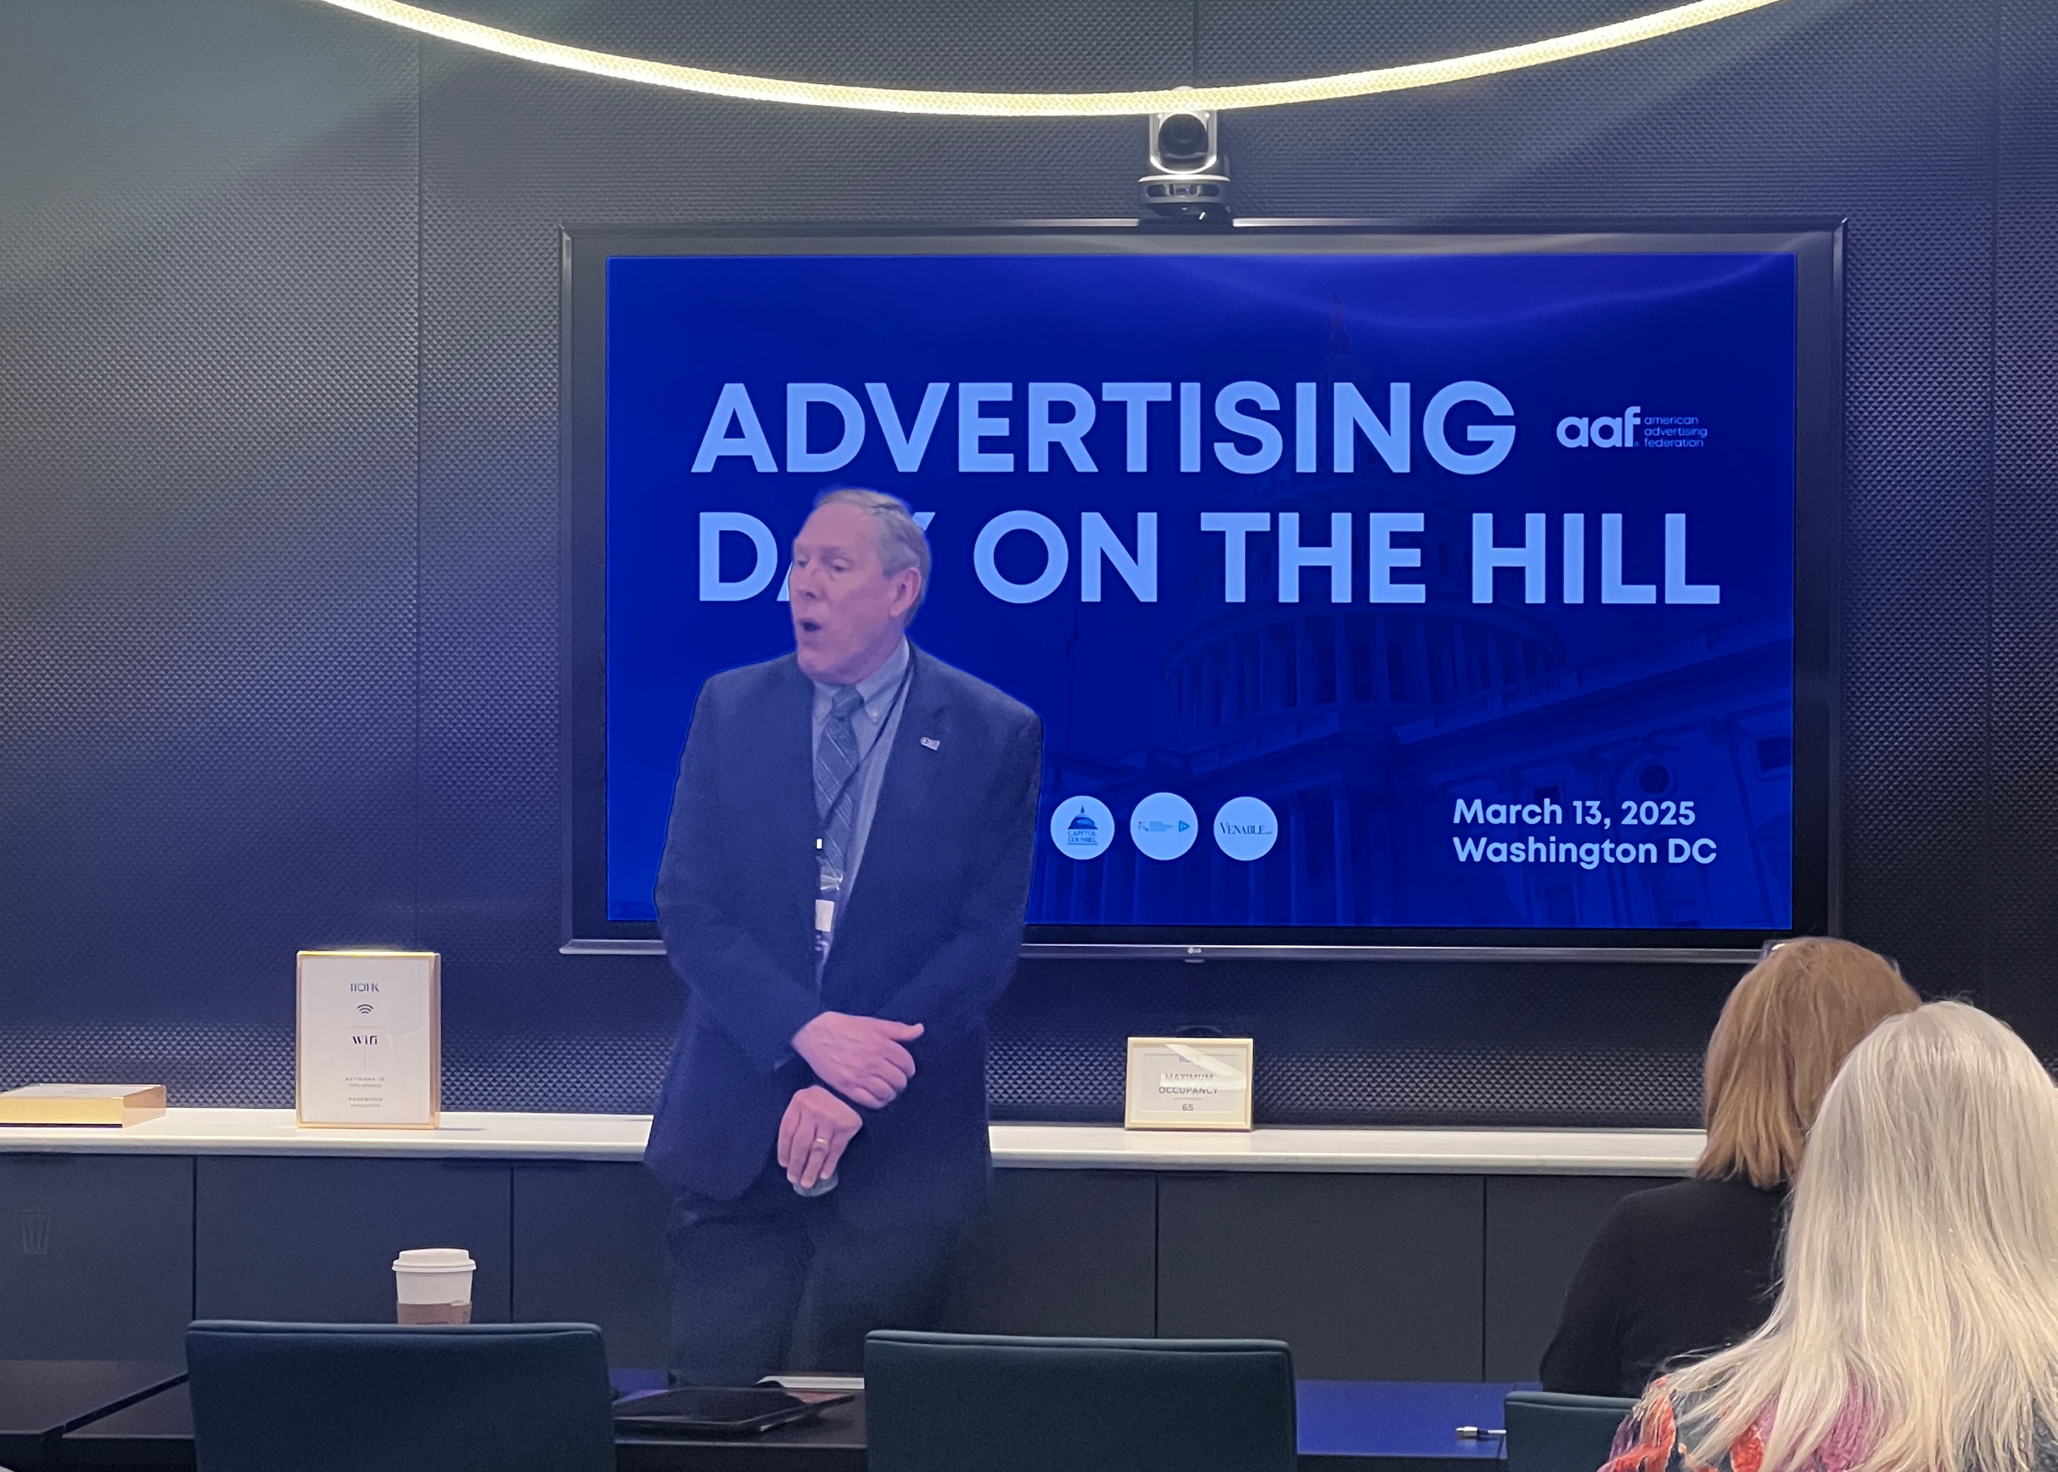
THE FIRST STEP
The first step in building an effective government affairs program is appointing a legislative chair —a committed, credible, and connected leader respected within the industry and capable of devoting time to advocacy. We recommend finding a member who has a passion for political/government affairs issues and appointing him or her to a two-year term.
If there is enough interest, appointing a vice chair and legislative committee helps share responsibilities, train future leaders, and increase member participation.

Slide 7
BUDGETING FOR GOVERNMENT AFFAIRS

Slide 8
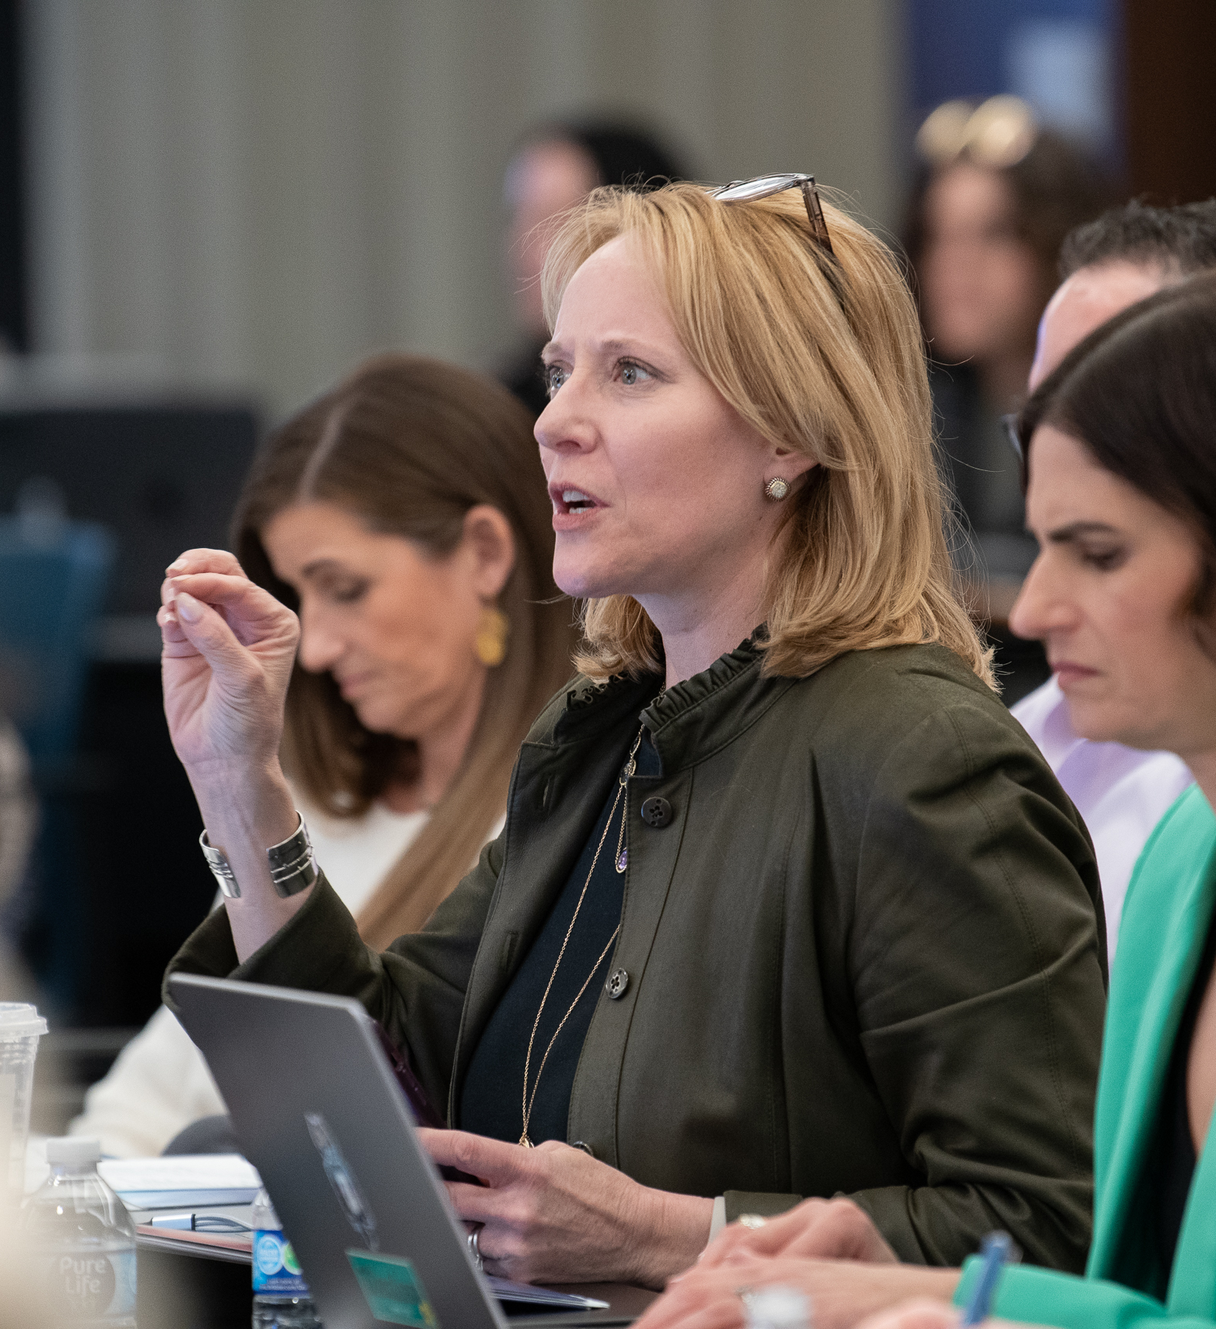
BUDGETING
If feasible, chapters should consider including a budget line item for government affairs to include minor expenses such as travel, or event costs. Every other year following national elections, AAF hosts the Advertising Day on the Hill event in Washington, DC. Chapters should budget to send the legislative chair to this important event.

Slide 9
EDUCATING MEMBERS ABOUT GOVERNMENT AFFAIRS

Slide 10
EDUCATION OPPORTUNITIES
Members should understand how legislation impacts their work and the industry. Ongoing education builds engagement and readiness in case of legislative action. Incorporate government relations into chapter activations through:
Board reports from the legislative chair on state and national issues
Occasional updates at membership meetings when something significant has happened in Washington, DC or another state
Newsletter columns summarizing legislative activity
Resources like AAF’s Government Report and AAF staff in Washington can provide updates and guidance.
Highlighting government affairs issues helps raise awareness of it as a tangible membership benefit, helpful in members recruitment and retention efforts.
Members should understand how legislation impacts their work and the industry. Ongoing education builds engagement and readiness in case of legislative action. Incorporate government relations into chapter activations through:
Board reports from the legislative chair on state and national issues
Occasional updates at membership meetings when something significant has happened in Washington, DC or another state
Newsletter columns summarizing legislative activity
Resources like AAF’s Government Report and AAF staff in Washington can provide updates and guidance.
Highlighting government affairs issues helps raise awareness of it as a tangible membership benefit, helpful in members recruitment and retention efforts.
Learn more about the various Government Affairs & Policy resources from the AAF

Slide 11
SURVEY MEMBER CONTACTS WITH LAWMAKERS

Slide 12
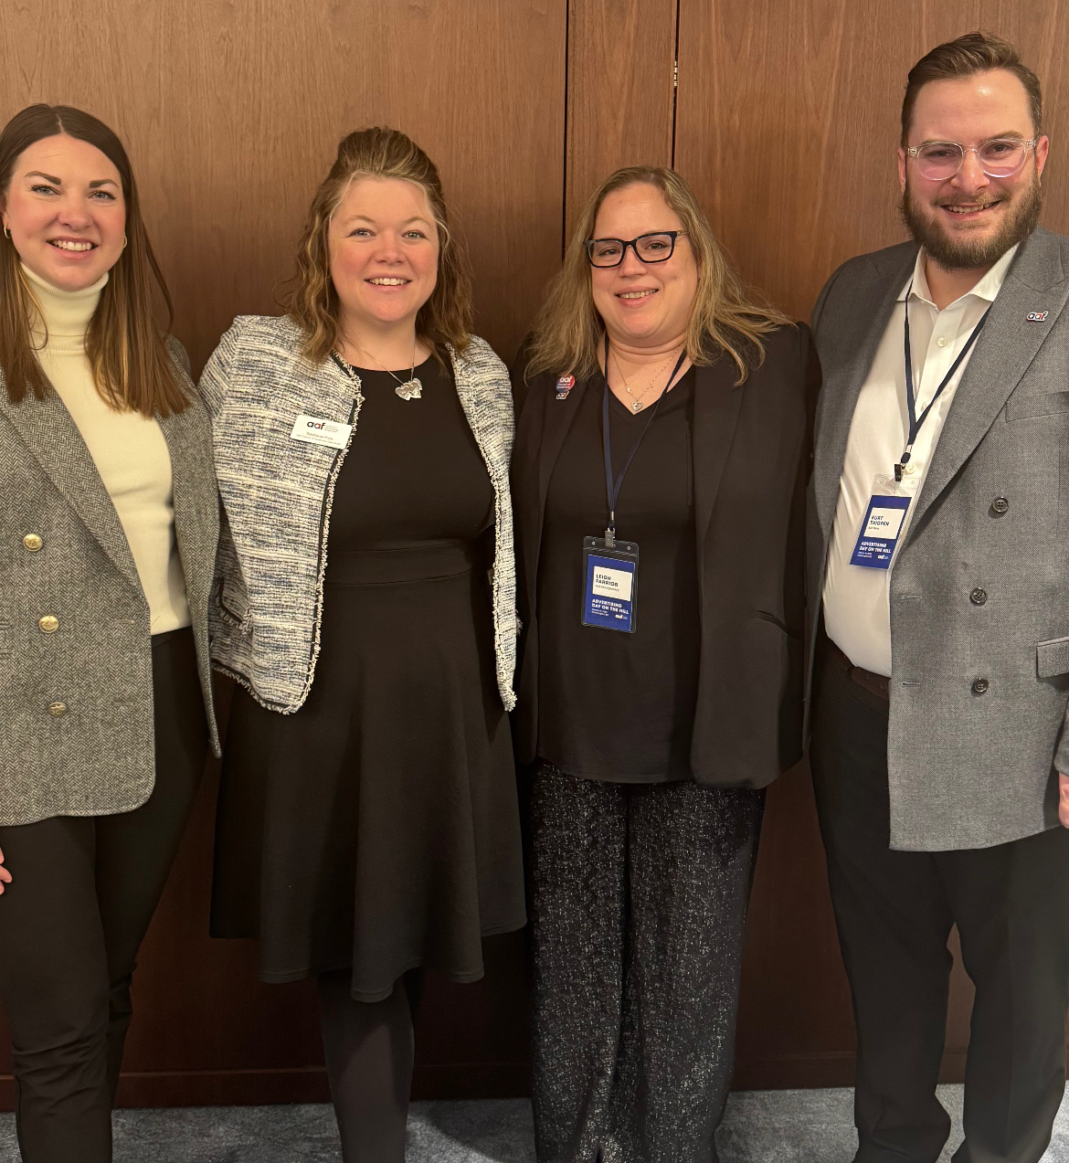
RELATIONSHIPS
Identify which members have personal or professional ties to legislators—these relationships are invaluable. Distribute a contact survey after each election to capture updated information on members’ relationships with local, state, and federal lawmakers. Compile a master list to quickly connect the right member with the right official when action is needed.

Slide 13
IDENTIFY INDUSTRY SPOKESPEOPLE

Slide 14

IDENTIFYING
Create a diverse pool of advertising professionals willing to testify or meet with lawmakers. Include representatives from agencies, media, clients, academia, and ensure geographic variety to cover multiple districts. Lawmakers are more receptive to people they know, so use existing relationships where possible.

Slide 15
COORDINATING STATEWIDE ACTIVITY

Slide 16
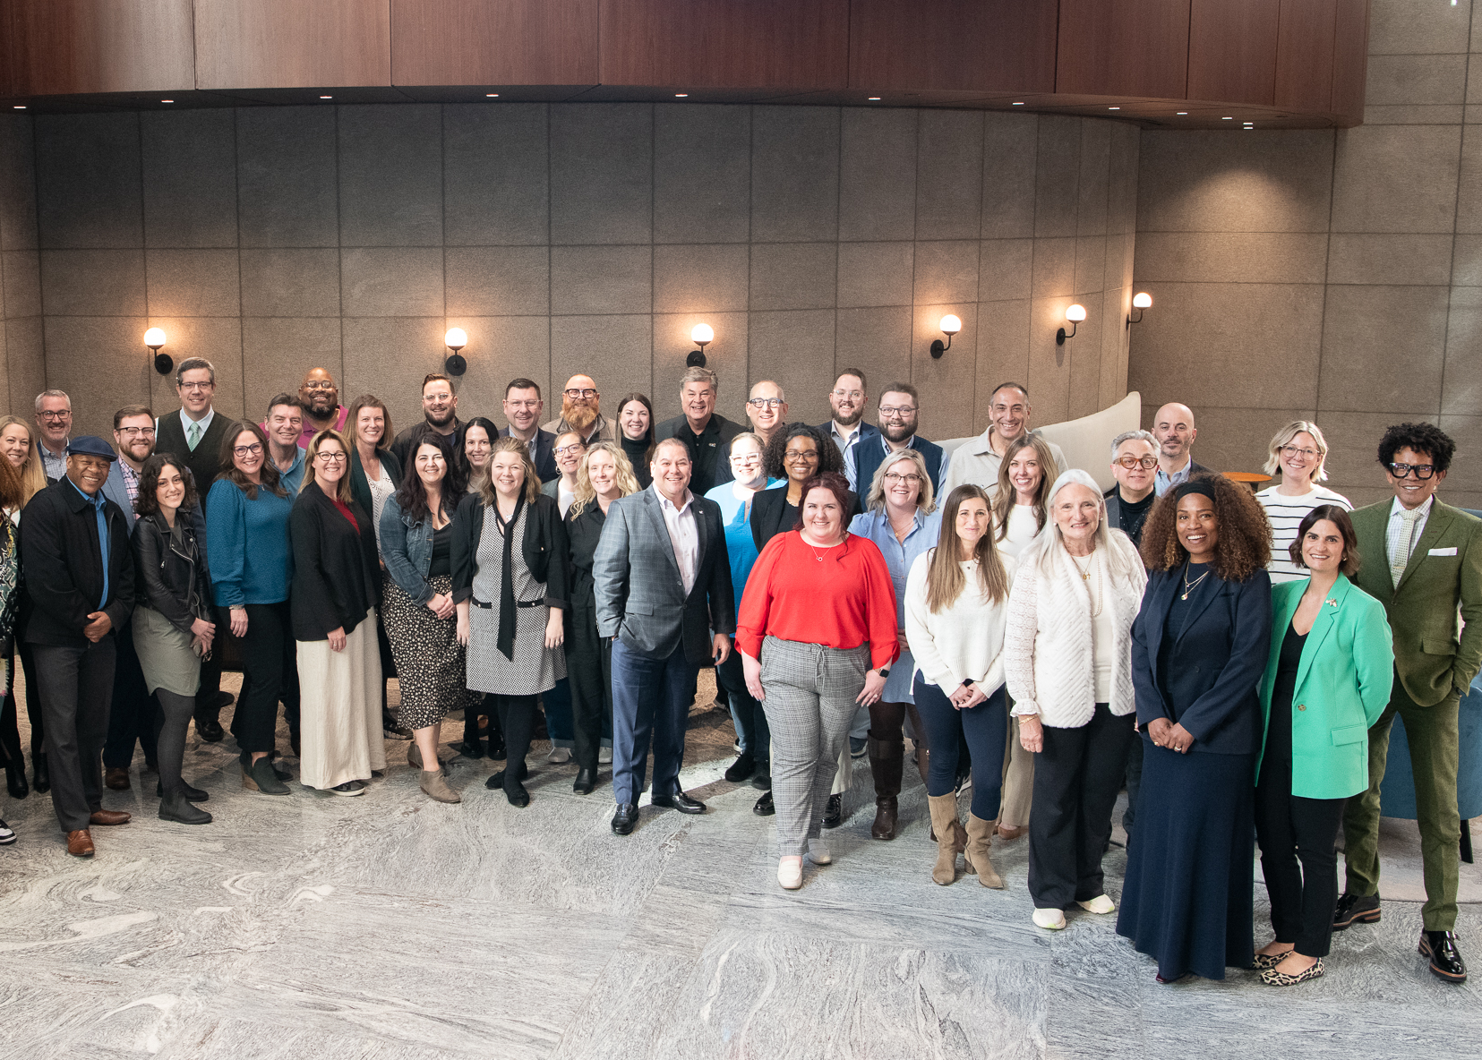
COORDINATING
STATEWIDE ACTIVITY
Learn more about the various Government Affairs & Policy resources from the AAF
Cooperation among clubs strengthens the industry’s voice. Legislative chairs should communicate regularly with counterparts across the state to share information and align strategies. Annual calls or meetings – perhaps at district conferences —help unify efforts.
Establish contact with related associations, such as broadcasters and publishers. Many already employ professional lobbyists who can provide insight. Collaboration ensures advertising’s interests remain visible and prevents lawmakers from exploiting division within the industry.

Slide 17
WORKING WITH LAWMAKERS IN THE ADVERTISING INDUSTRY

Slide 18

EDUCATING LAWMAKERS
The most important thing your chapter’s government affairs program can do is educate area lawmakers (local, state and federal) about the advertising in their jurisdictions. AAF has economic data showing the number of jobs and economic activity supported by advertising in every state and congressional district in the country.
Ensure lawmakers are added to your distribution lists and receive any newsletters, notifications, or other communications that are sent to chapter members. The mailings may not be read, but their receipt will help raise awareness of your AAF chapter and local advertising industry.

Slide 19
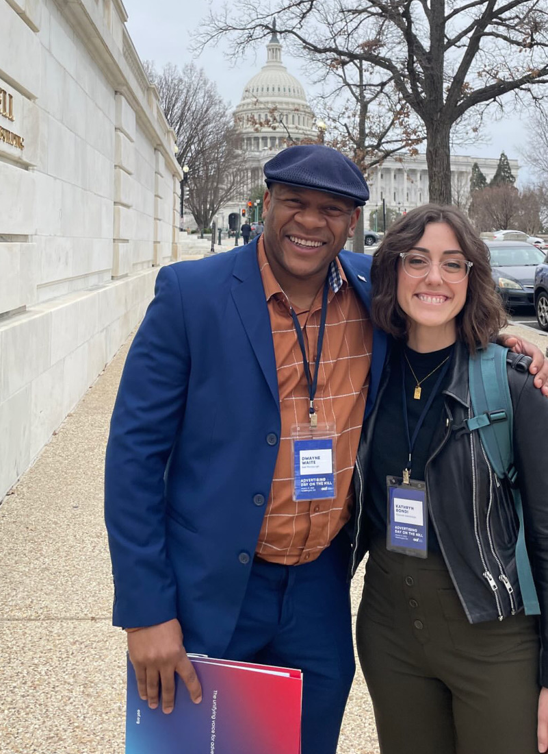
INCLUDING LAWMAKERS
Consider finding ways to include lawmakers in chapter activities. Some may be potential speakers for a membership meeting. You may want to invite an important lawmaker to present an award at your American Advertising Awards show. That will simultaneously show off the best of the local industry to the lawmaker and give him/her some wanted visibility with an important audience.
If your chapter creates a public service campaign, make sure you send information to local lawmakers. This is a great way to show how the industry uses its talents and expertise to service the community. If there is a kick-off event, there may be a way to involve some lawmakers to give them some “ownership” of the campaign.

Slide 20
MEETING WITH LAWMAKERS
On occasion, there may be the opportunity or need, to meet with a lawmaker for a courtesy call or visit to advocate for or against specific legislation.
When possible, a delegation should include representatives from multiple aspects of the industry – clients, agencies, media, and suppliers. Use your legislative contact survey to include people with preexisting relationships with the lawmaker.
Before meeting, participants should plan key points and assign roles to ensure efficient use of time. Offer the chapter as future resource on advertising issues. If the visit is to discuss a particular issue or piece of legislation, after presenting your position and reasons be sure to conclude with a direct and explicit request for support. Leave behind a concise position paper with contact information. AAF national office can assist with preparing these materials.
After every meeting, send a thank-you letter and promptly deliver any promised follow-up information.

Slide 21
HOSTING LEGISLATIVE EVENTS
Special events help foster strong relationships between the advertising community and lawmakers. Always maintain a nonpartisan approach.
Just as AAF conducts Advertising Day on the Hill in Washington, DC, in many states the AAF chapters work together to host an AAF Day in the State Capitol. These events can be as elaborate or simple as the local industry desires. Some states follow the Day on the Hill model with a morning program for delegates featuring education about issues followed by legislative visits. Others host a reception and invite lawmakers to attend. Still others simply organize small delegations of industry representatives to walk the halls of the Capitol and meet with legislators. There is no right or wrong way to have a Day in the Capitol. AAF national office can connect you with AAF members in other states who have had events to discuss ideas.
Some things to think about while planning include:
Check state ethics laws on meals or gifts.
Use contact survey data for invitations.
Choose dates that align with the legislative calendar.

